Slide 1
Facebook Pixels
Setup and Utilizing Facebook Pixels

Slide 2
Why use a pixel?
Provides insights on the traffic driven to your website from Facebook
Understand success of ads you run through Facebook
Strengthen targeting and retargeting of ads
Design conversions for particular events (sign ups for newsletter, reservation for event, etc.)

Slide 3
Why use a pixel?
The pixel is tracking what pages within your website people are visiting, the device they are using to see a page and what action they took (e.g. registered for an event)

Slide 4
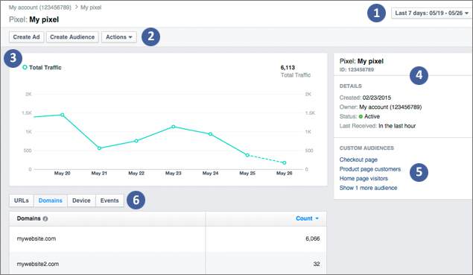
Why use a pixel?
Data that is collected:
Time Frame (1)
Toolbar (2)
Traffic Data (3)
Pixel details (4)
Custom Audiences (5)
Data Filters (6)

Slide 5
Create a Pixel
Be on the main page of Business Manager
In Assets, you will see Pixel
Create Pixel
Business Manager will automatically set it up under your organization’s name

Slide 6
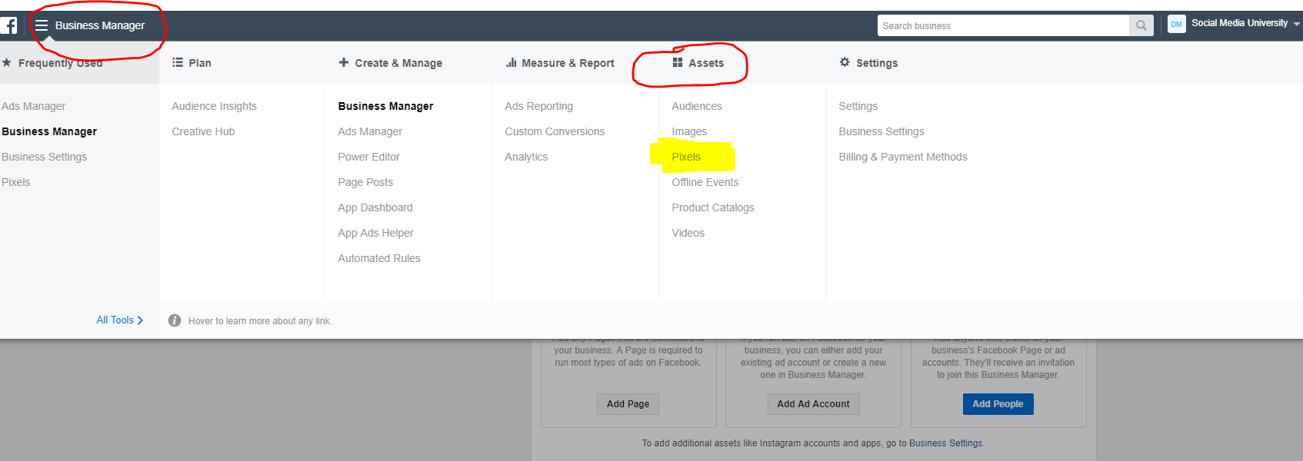
Create a Pixel

Slide 7
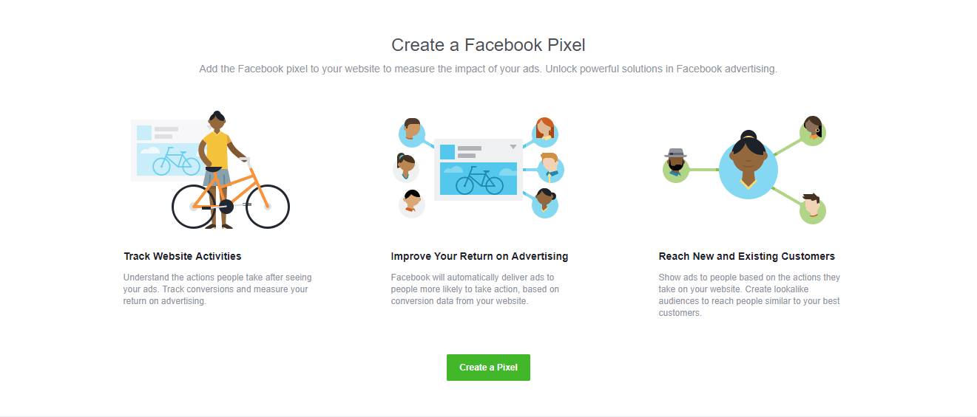
Create a Pixel

Slide 8
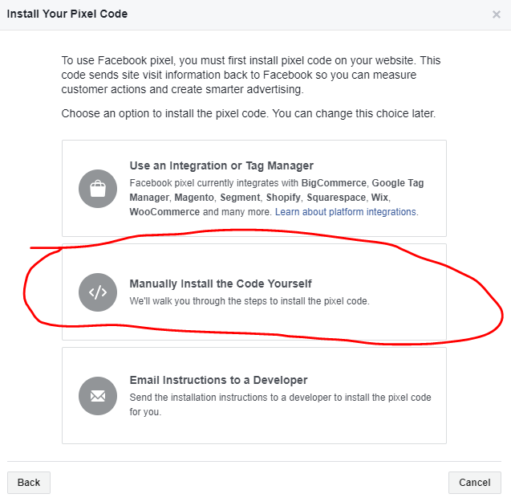
Installing Pixel
Manually Install the Facebook Pixel

Slide 9
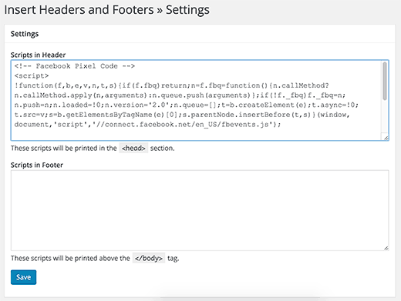
Installing Pixel
Copy and paste the code given in the Header section of “Headers and Footers” script of Wordpress website

Slide 10
Installing pixel
If you use a third-party platform for your website, click here to find out how to install your pixel code

Slide 11
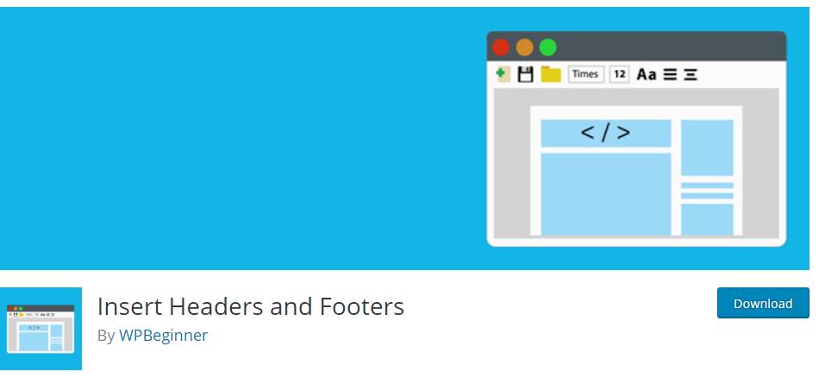
Installing Pixel
Use A Header and Footer Plugin from Wordpress
Click here to Download Headers and Footers Plugin

Slide 12
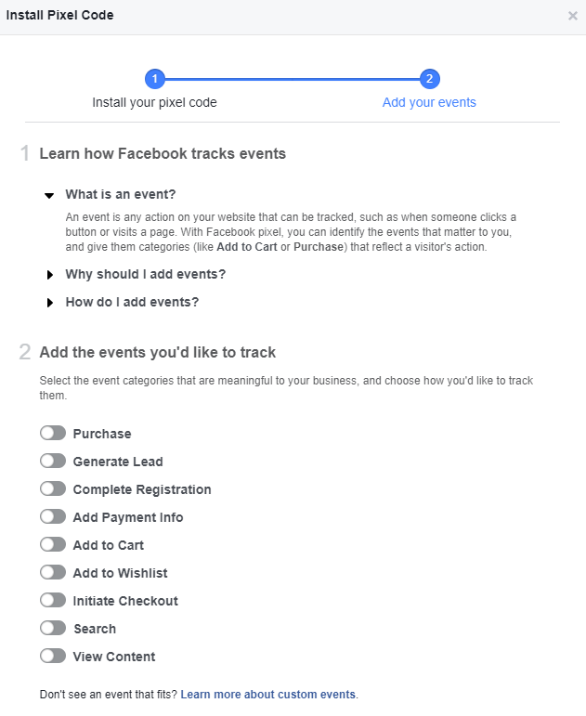
Tracking events
Remember, any action that is taken from Facebook to your website is being tracked
Identify events that matter to you (such as “Generate Lead” “Complete Registration” or “Purchase”
Each event will have provide a code you can place within a certain web page

Slide 13
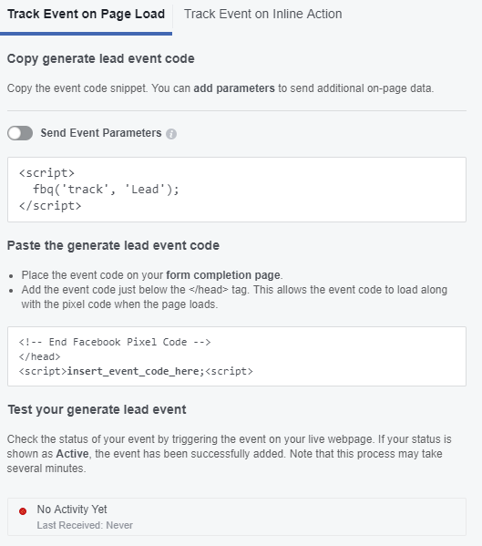
Tracking events
Each event will provide a code you can place within a certain webpage.
Place upon a Thank You or Completion page
[ADVANCED] Customize event parameters
Provide a conversion value or currency

Slide 14
Thank you
Deontae Moore is a Social Media Community Manager for Jeffery M Consulting (McDonald’s)

