Slide 1

There’s data!
Let’s collaborate!

Slide 2

Collaborating on data journalism projects
Defining roles/tasks/duties
Knowing the data
Analyzing the data
Documenting your analysis/transparency
Reporting beyond the data
Presentation

Slide 3

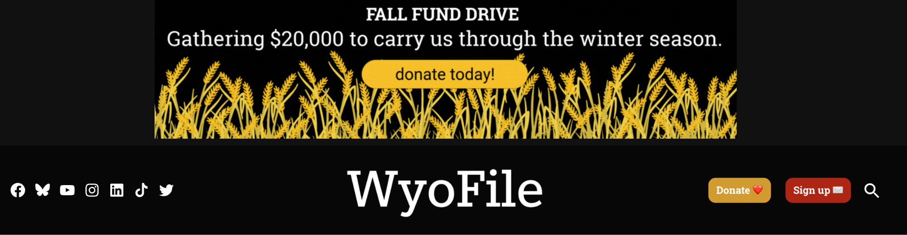
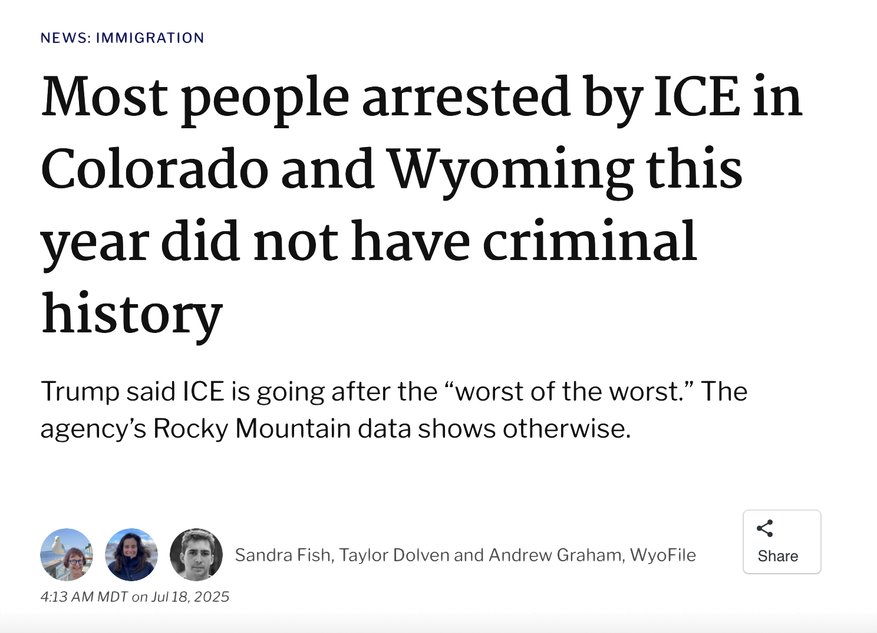
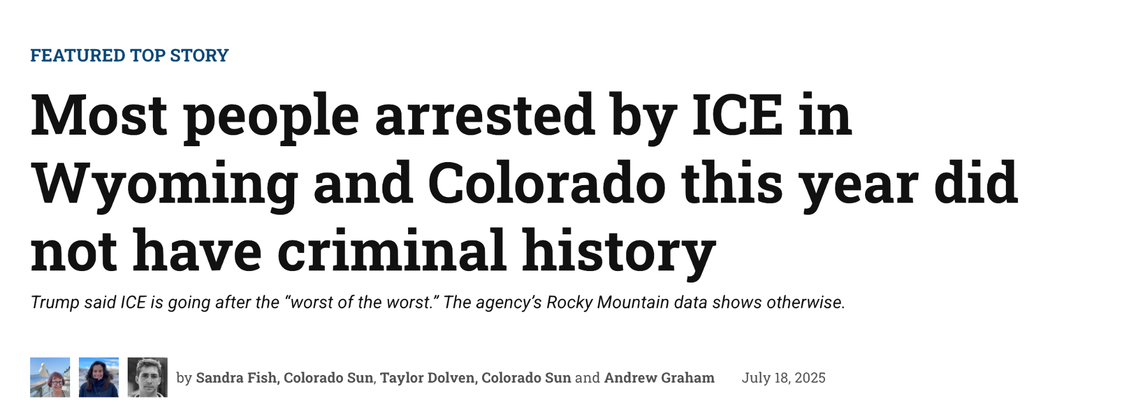
A collaboration example

Slide 4
Who is collaborating? What are their roles?
Digital
Editor/s
Data journalist
Photographer
Graphics
Reporter/s
Notes:
Our project reality: this was reporter-generated and led; we had one meeting with editors as we started.

Slide 5
Where did the data come from?
Academia
Other news orgs
Crowd-
sourced
Scientific
poll
Government
Think
tank

Slide 6
Questions to ask about the data
Is it original?
Who entered it?
Crowd-
sourced?
Scientific
poll?
How was it obtained?
Is it the full data set?

Slide 7
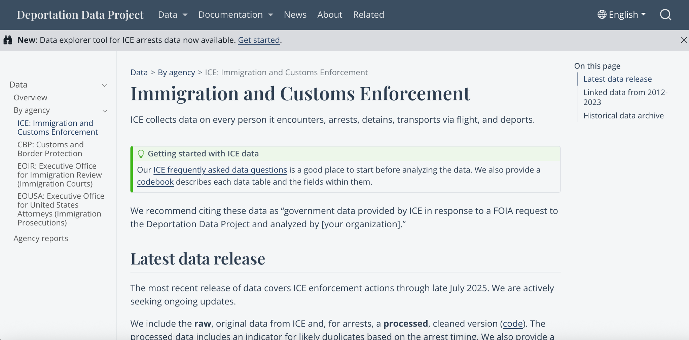
Our data source — academic project
via FOIA

Slide 8
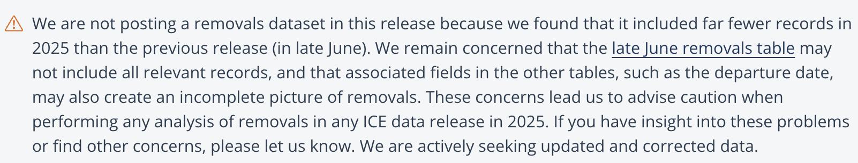
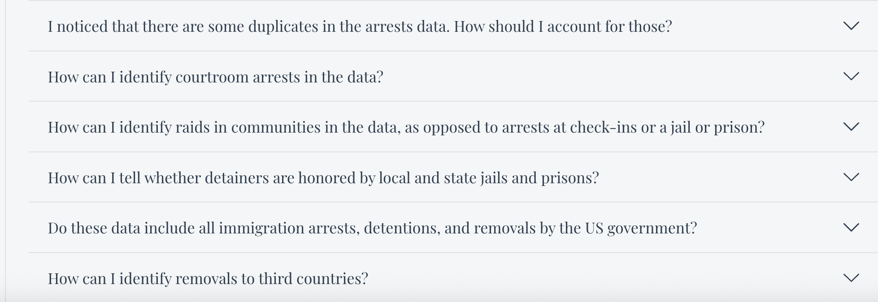
Caveats galore!

Slide 9
How is the data being analyzed?
Judgment calls!
Keep a diary/record
Does the
data need cleaning?
What software is being
used?
Are there duplicates?

Slide 10
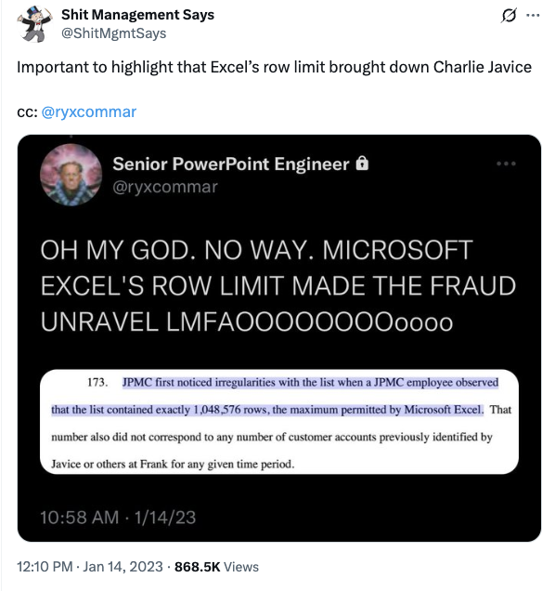
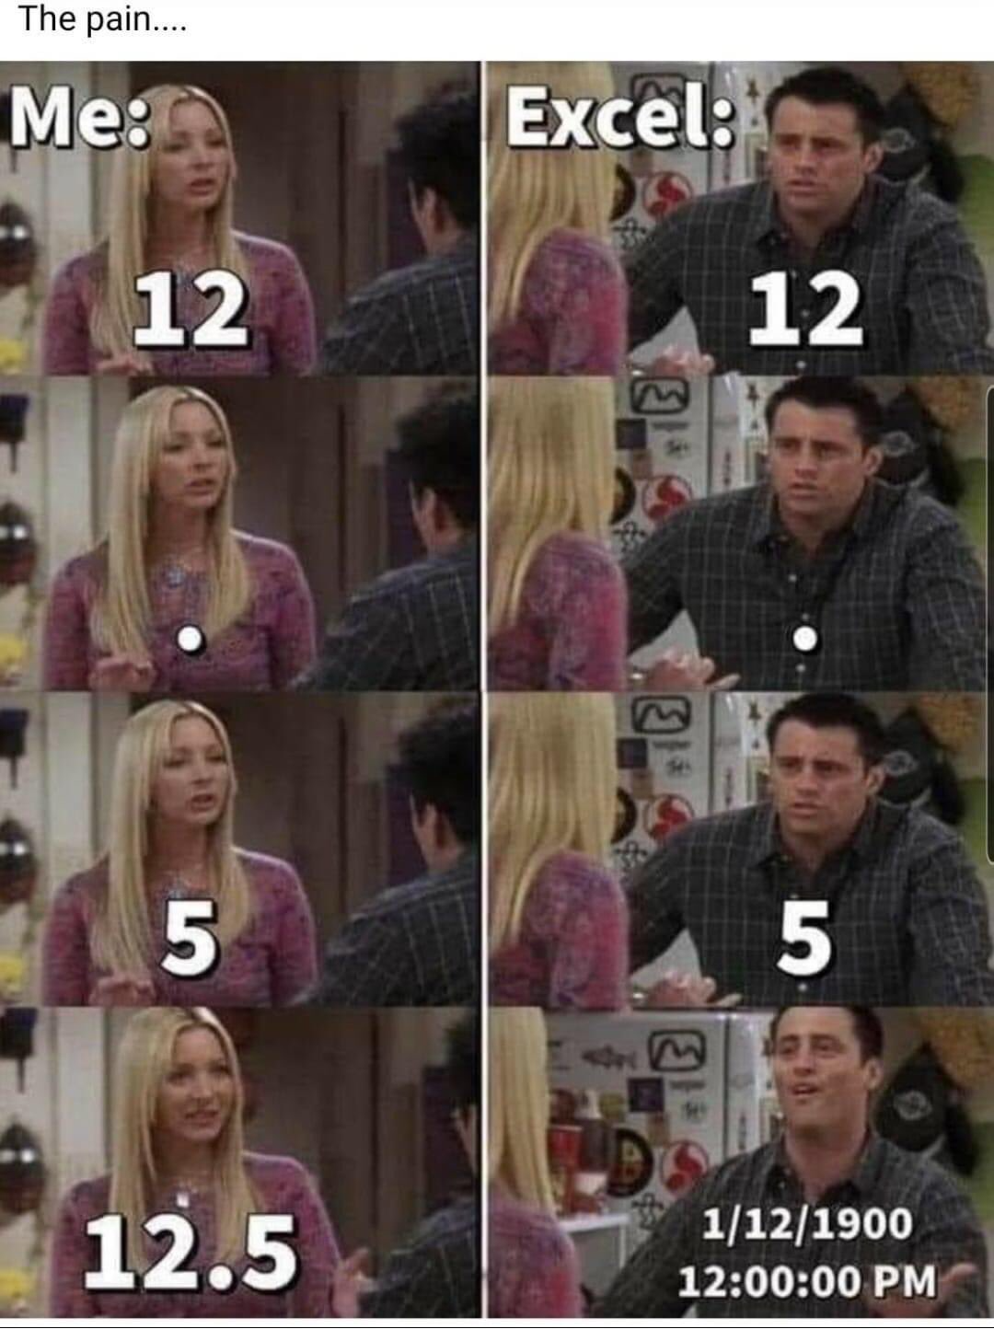
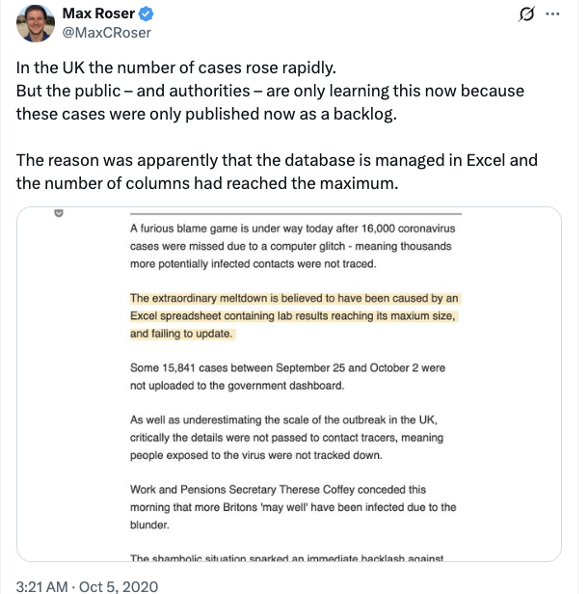
Excel issues…
Notes:
That middle one is date magic

Slide 11
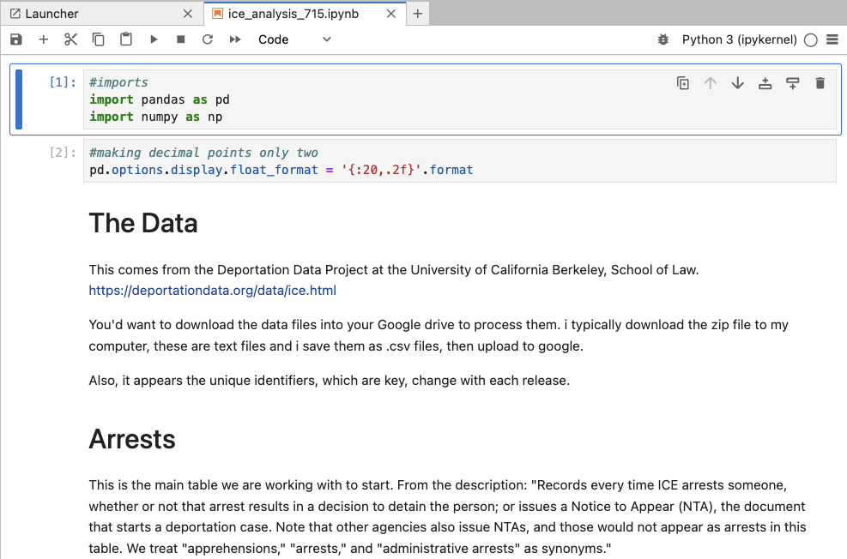
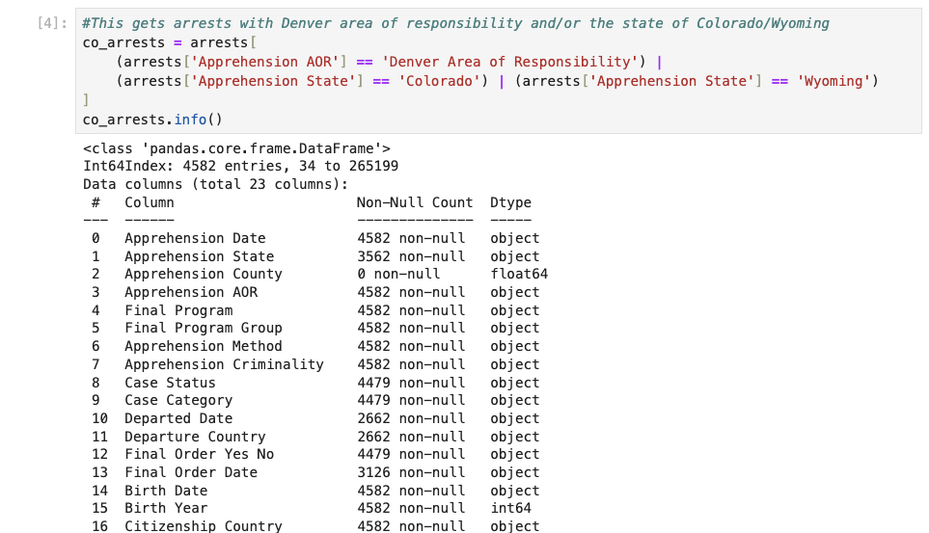
Replication is good… this is a Python/Pandas example
Notes:
This also documents a portion of my process… worth noting that i did this three times before i was satisfied with my procedure, then a fourth with new data

Slide 12
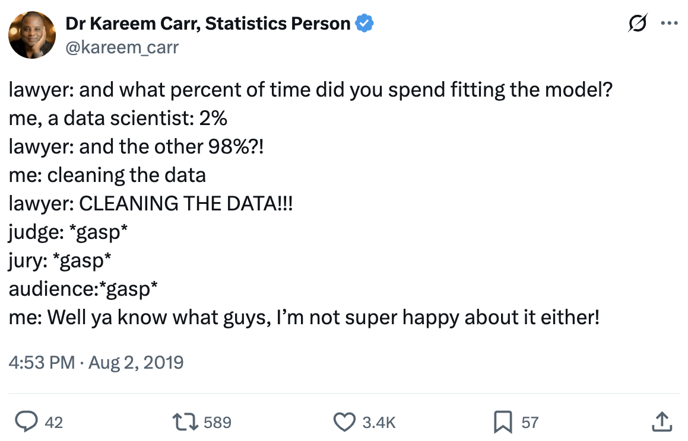
Notes:
This also documents a portion of my process… worth noting that i did this three times before i was satisfied with my procedure, then a fourth with new data

Slide 13
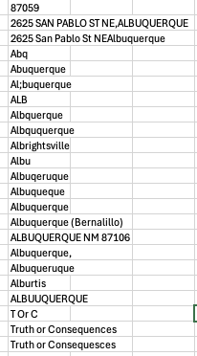
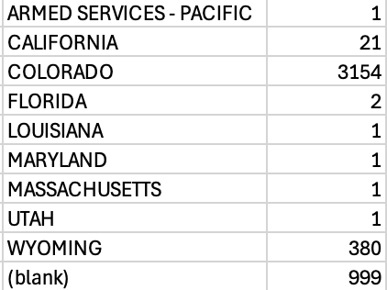
A couple of examples …

Slide 14
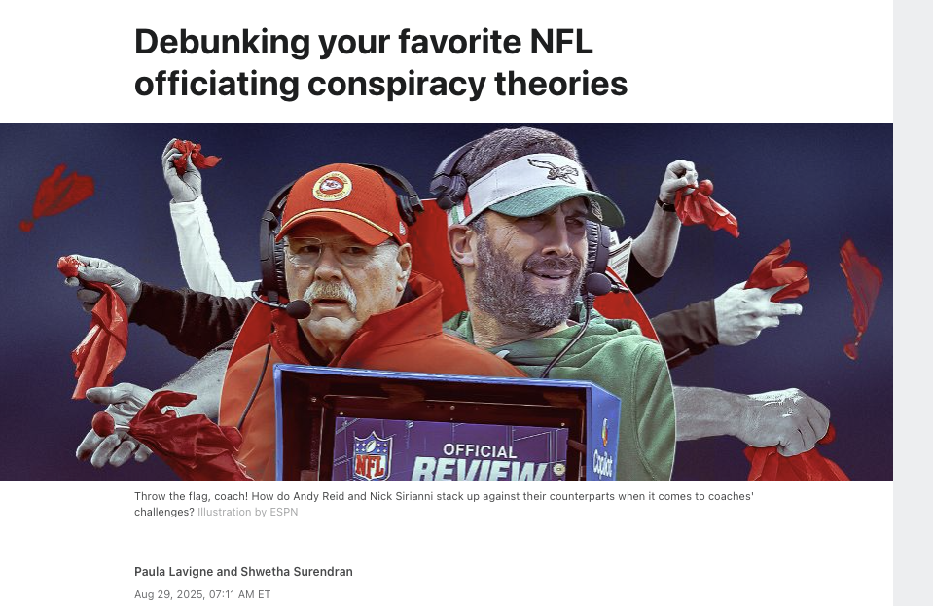
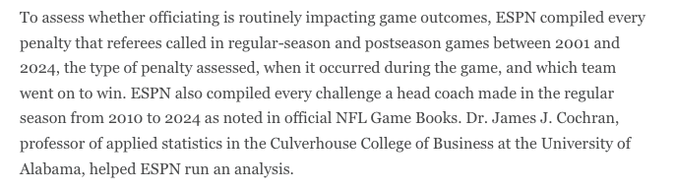
Asking others for review …
Notes:
With ESPN arena food inspections, we went back to each jurisdiction and shared our results - the Detroit example

Slide 15
What story does the data tell?
Who are the real people?
What are the photos/
graphics?
What are the stories/
structures?
Nerd box!
Big picture to smaller details

Slide 16
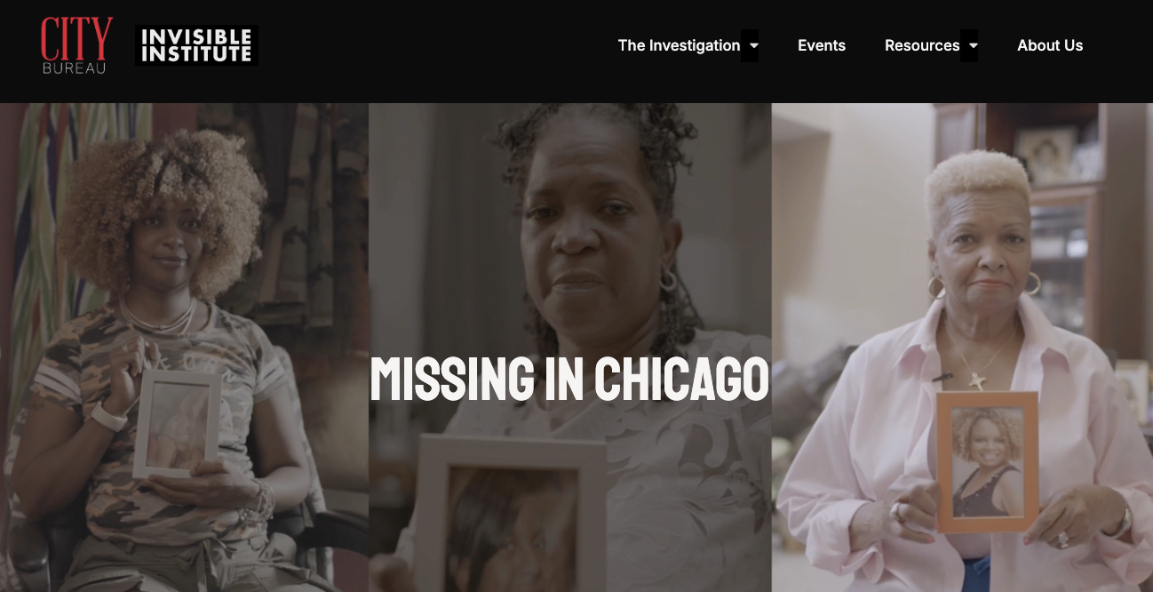
A great digital example …

Slide 17
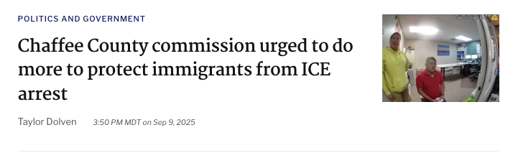
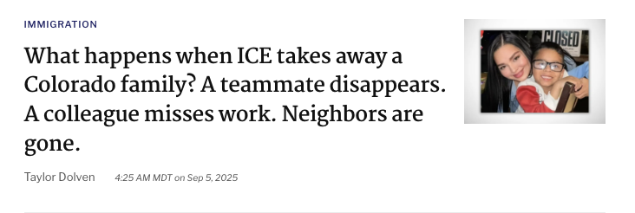
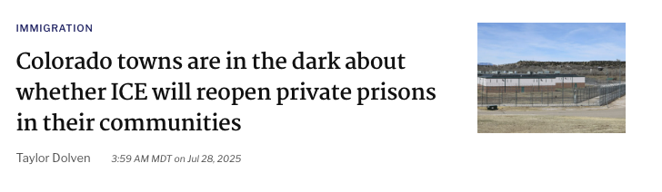
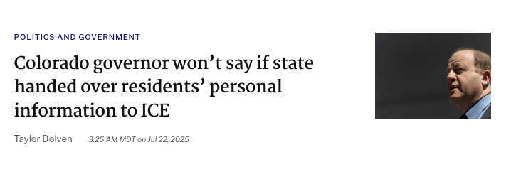
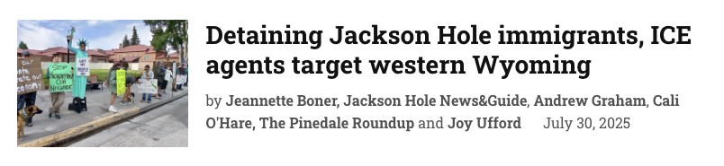
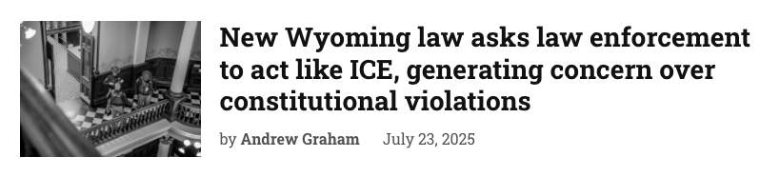
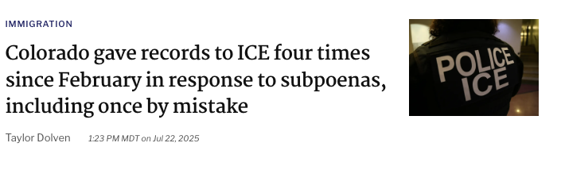
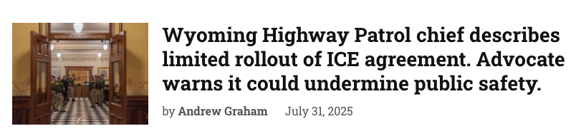
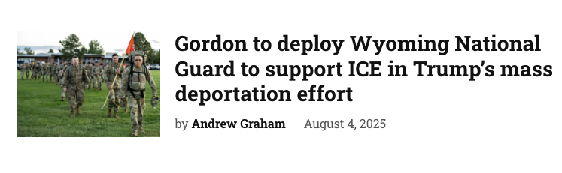
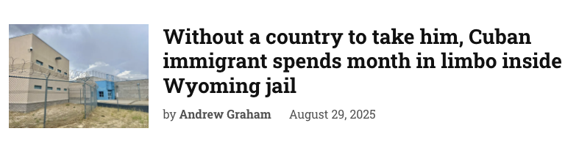
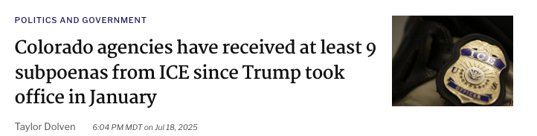
One initial story, with follow ups

Slide 18
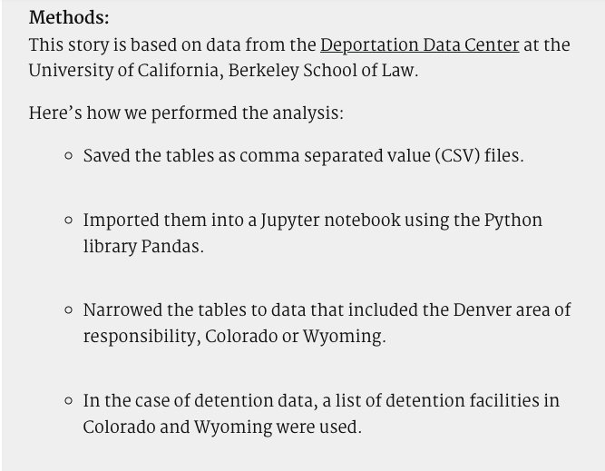
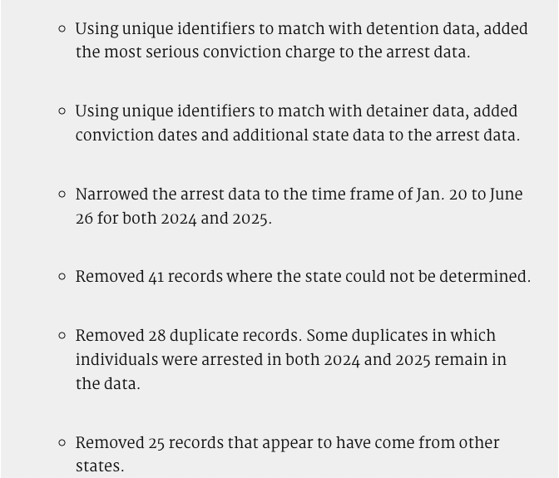
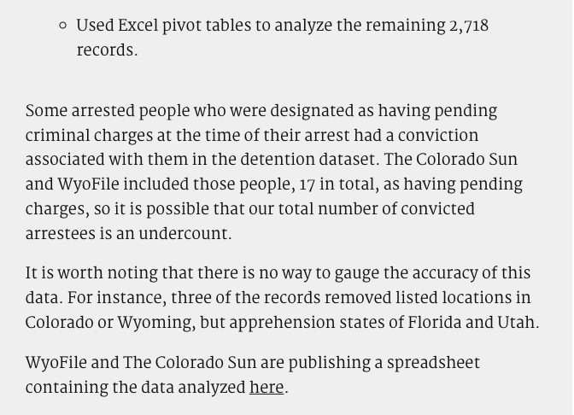
Nerd Box! Transparency! How we did this:

Slide 19
Questions?
Contact me: fishnette@gmail.com

